Slide 1

RBL- RESEARCH BASED LEARNING
Driver Anti-Sleep Device
S.NO | Name | Roll No. | Branch & Section
01 | Nemmani Sasidhar | 20951A05G2 | CSE-B
02 | SK. Shaheed | 20951A05G8 | CSE-B

Slide 2
HIGHLIGHTS
Falling asleep on the steering can lead to serious consequences, there may be accidents and people may even lose their lives.
This situation is much more common and hence, it is very important to counter this problem.
So to address this issue, we have come up with a Driver Anti-sleep Device.
This system alerts the user if he/she falls asleep at the steering thereby, avoid accidents and saves life.
2

Slide 3
ABSTRACT
The Drive Anti-Sleep Device (DASD) is an innovative solution aimed at detecting and preventing accidents caused by driver fatigue. It incorporates a range of monitoring techniques, including physiological and behavioral analysis. By analyzing factor such as head movements the DASD can accurately identify signs of drowsiness. When fatigue is detected, the device promptly initiates interventions such as auditory alarms, to help the driver remain attentive and focused. Extensive testing and simulation studies have demonstrated the DASD's effectiveness in preventing drowsiness-related accidents, thereby contributing to improved road safety. Further advancements and research are being pursued to enhance the device's capabilities in mitigating the risks associated with driver fatigue.

Slide 4
Problem Performance
The performance of Drive Anti-Sleep Devices is dependent on their ability to accurately detect signs of drowsiness and initiate timely interventions.
Factors such as individual variations in driver responses and environmental conditions can impact the accuracy of detection, leading to false positives or negatives.
Developing robust devices that can adapt to diverse driving scenarios and effectively differentiate between genuine fatigue and momentary lapses in attention is crucial.
2

Slide 5
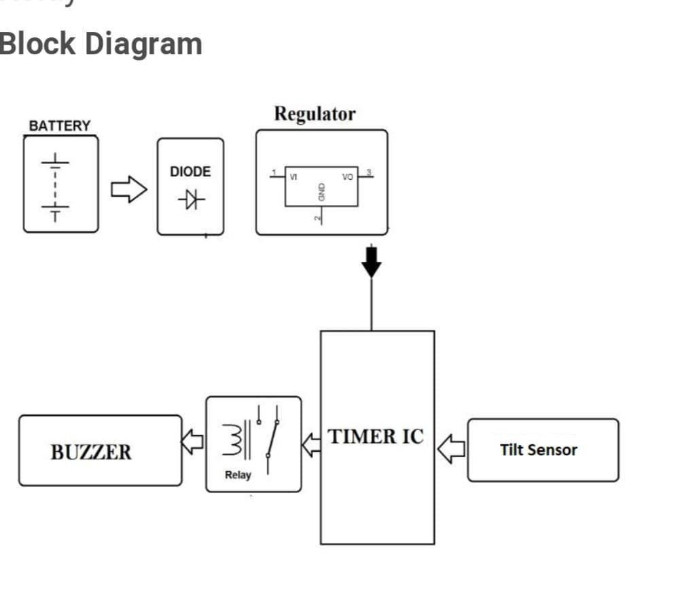
METHODOLOGY
vacuum tube diode
5,12, 15 V
9 VOLTS DC
RL1
PIEZO
555 timer IC

Slide 6
The circuit is built around Schmitt trigger, timer IC, transistor, a relay and a logic gate. Around half an hour after the reset of timer IC, transistors rive the buzzer to sound an intermediate beep.
If timer IC is not reset at that time, around one minute later the output of gate conducts. Due to this the clock stops counting further and relay energizes to deactivate the load. This state changes only reset switch is pressed.
As a result of pressing the reset switch a next timer is set which will trigger the same events after half an hour.

Slide 7
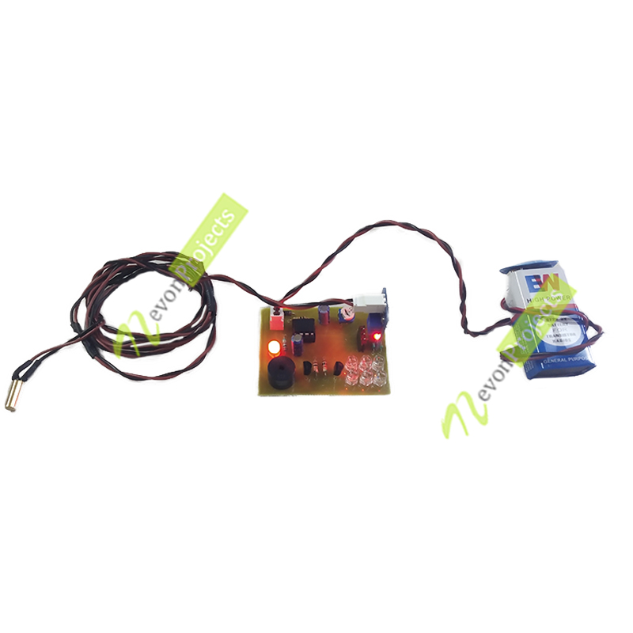
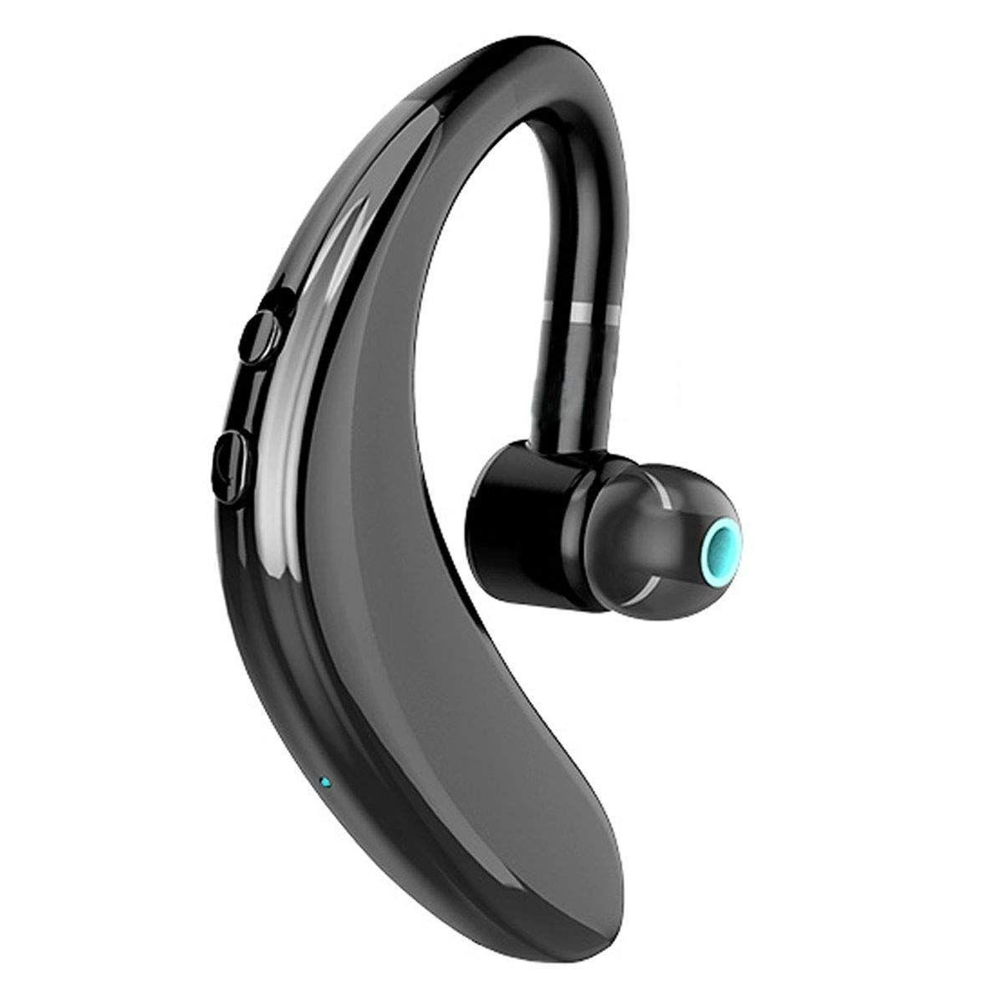
Potential Markets
This product has a potential market where most of the drivers prefer to buy this product.While travelling for longer distance.

Slide 8
Working
Sensor Integration: DASDs incorporate various sensors to gather data related to driver head movements. These sensors may include head movement tracking devices. The sensors capture real-time information to assess the driver's state.
Fatigue Detection: The algorithms assess multiple parameters to detect fatigue. For example, head movement tracking devices monitor head movements to identify indicators of drowsiness.

Slide 9
Alert and Intervention: Upon detecting signs of fatigue, DASDs initiate timely interventions to keep the driver alert and focused. These interventions can include auditory alarms. The alerts and feedback aim to stimulate the driver's senses and increase alertness, preventing potential accidents caused by drowsy driving.

Slide 10
Conclusion
The design of the manufactured device is simple and can be handled easily.
This can be manufactured at lower cost and materials used in this device are easily available .
So at low cost this device help many people.

